Slide 1
Smart Sunburn
Warning Patch
Electronics Systems Packaging
Siddhant Deore | IIIT Bangalore | Apr 2026

Slide 2
Problem Statement
02
☀
👁
📡
UV Radiation Risk
Invisible Hazard
No Wearable Solution
Excessive UV exposure is a leading cause of sunburn, premature ageing, and long-term skin damage including melanoma.
Users cannot perceive UV intensity in real time. Cloud cover and reflective surfaces create misleading conditions.
Existing tools (UV index apps) are coarse, location-based, and not personalised. A compact, body-worn monitor is missing.
→ A compact, wearable, real-time UV monitoring solution is required.

Slide 3
Proposed Solution
03
Key Components
The Smart Sunburn Warning Patch is a wearable embedded system that continuously monitors UV exposure and environmental conditions, then alerts the user before sunburn risk becomes critical.
ESP32-S3 MCU
BH1750 Light Sensor
Monitors UV radiation in real time
Tracks skin surface temperature
Measures ambient light conditions
Provides LED alerts
Compact embedded system design
Sensor fusion for accurate risk scoring
ML8511 UV Sensor
LED
TMP117 Temp Sensor
3.3V Battery + Regulator

Slide 4
System Architecture
04
Battery
(3.7V Li-Po)
MCU
ESP32-S3
LED
Alert
ML8511
UV Sensor
GPIO
3.3V Regulator
(LDO)
ADC
Vibration
Motor
TMP117
Temp Sensor
I²C
BH1750
Light Sensor
I²C
Interface key:
ADC – Analog
I²C – Digital
GPIO – Digital
Power Rail

Slide 5
Sensor Selection & Justification
05
☀ ML8511 — UV Sensor
Specifications
Justification
Output: Analog voltage proportional to UV intensity
Interface: ADC (0–3.3V)
UV range: 280–390 nm (UVA + UVB) causes sunburn
Directly measures UV radiation — primary sunburn driver
Simple ADC interface; low power consumption
Compact footprint suitable for wearable integration
🌡 TMP117 — Temperature Sensor
Specifications
Justification
Accuracy: ±0.1°C over full range
Interface: I²C (400 kHz), Resolution = 0.0078°C
Output: 0.0078°C {x Raw-value (16-bit)}
Skin temperature reflects cumulative thermal exposure
UV alone does not determine sunburn severity
High accuracy improves risk prediction model
💡 BH1750 — Ambient Light Sensor
Specifications
Justification
Range: 1–65,535 lux
Interface: I²C (400 kHz)
16-bit resolution, calibration-free
Provides environmental context (indoor vs. outdoor)
Helps validate UV sensor readings
Reduces false alerts in shaded or overcast conditions

Slide 6
System Working Principle
06
1
Sense
2
Convert
3
Process
4
Alert
▶
▶
▶
ML8511 measures UV intensity
TMP117 reads skin temperature
BH1750 measures ambient lux
ADC digitises ML8511 analog output
I²C bus transfers digital data from
TMP117 and BH1750 to MCU
ESP32-S3 fuses sensor data
Applies weighted risk algorithm
Determines exposure risk level
Green LED → safe
Amber LED → caution
Red LED + vibration → high risk
Risk Level Output
Low Risk
UV < 3, Temp normal
Moderate Risk
UV 3–6, Temp elevated
High Risk
UV > 6, Temp high

Slide 7
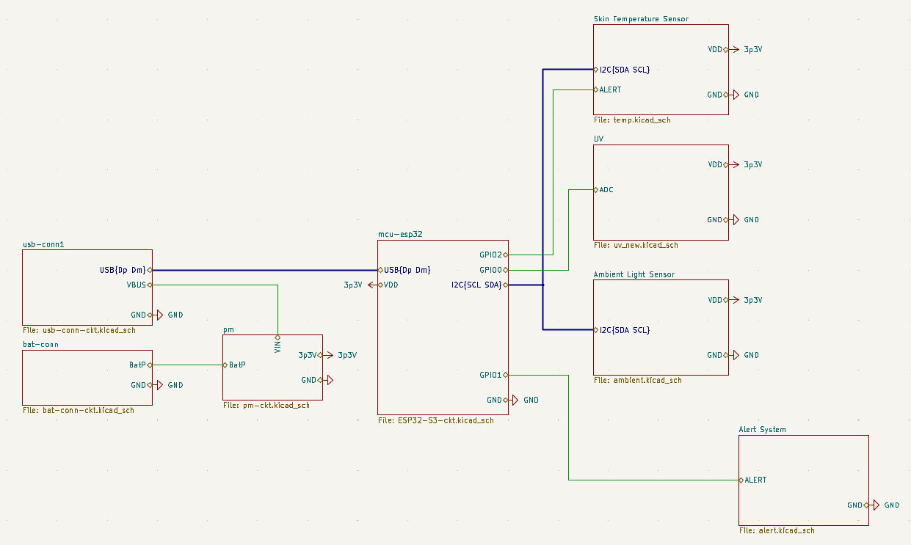
Root Schematic Overview
07
[ Insert Root Schematic Image Here ]
Power Rail (3.3V)
Single regulated 3.3V supply distributed to all ICs via power net.
I²C Bus
SDA/SCL shared between TMP117 and BH1750 with pull-up resistors (4.7 kΩ).
ADC Input
ML8511 analog output routed to ESP32-S3 ADC GPIO pin.
Alert Outputs
GPIO lines control LED driver and vibration motor transistor.

Slide 8
Key Hardware Design Choices
08
01
Single 3.3V Power Rail
02
Mixed-Signal Design
All components operate at 3.3V, simplifying power distribution and eliminating level-shifting circuitry.
Combines analog front-end (ML8511 → ADC) with digital I²C peripherals in a partitioned layout to minimise interference.
03
I²C Bus Topology
04
Pull-Up Resistors
TMP117 and BH1750 share the SDA/SCL bus, reducing GPIO usage and wiring complexity on the compact PCB.
4.7 kΩ pull-up resistors on SDA and SCL ensure reliable I²C communication per NXP specification.
05
Decoupling Capacitors
06
GPIO Alert Control
100 nF ceramic capacitors placed at each IC power pin suppress high-frequency noise and ensure signal integrity.
Transistor-driven alert outputs protect MCU pins from current overload when driving LED and vibration motor.

Slide 9
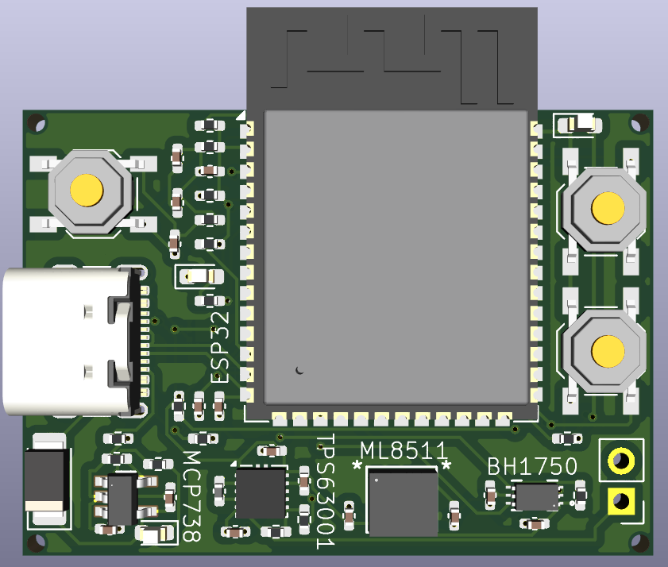
PCB Design
09
[ Insert PCB Layout Image Here ]
Compact Placement
All ICs arranged within a 39 × 28 mm footprint for wearable compatibility.
Analog/Digital Separation
ML8511 analog section isolated from digital I²C area to minimise noise coupling.
I²C Routing
Short, matched-length SDA/SCL traces away from power plane switching transients.
Decoupling Placement
100 nF capacitors placed within 1 mm of each IC VCC pin.
Power Routing
Wide copper pours (0.5 mm+) on 3.3V rail minimise resistive voltage drop.

Slide 10
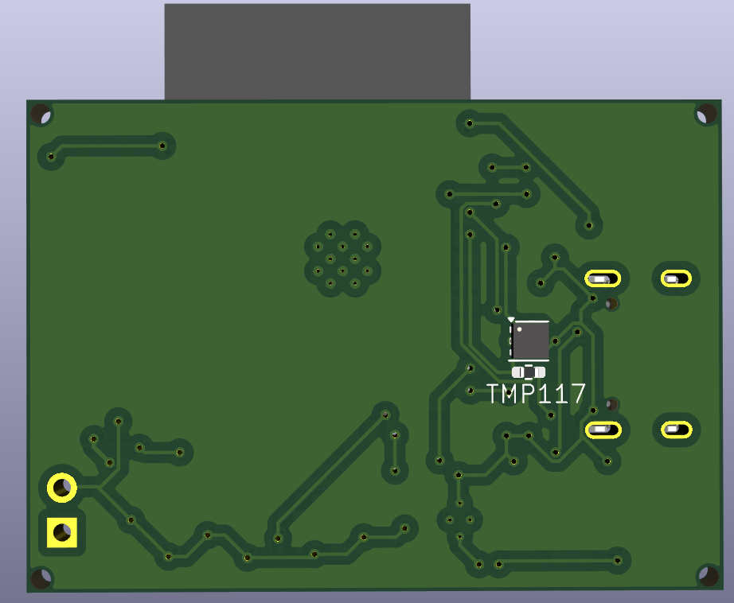
PCB Design
09
[ Insert PCB Layout Image Here ]
Compact Placement
All ICs arranged within a 39 × 28 mm footprint for wearable compatibility.
Analog/Digital Separation
ML8511 analog section isolated from digital I²C area to minimise noise coupling.
I²C Routing
Short, matched-length SDA/SCL traces away from power plane switching transients.
Decoupling Placement
100 nF capacitors placed within 1 mm of each IC VCC pin.
Power Routing
Wide copper pours (0.5 mm+) on 3.3V rail minimise resistive voltage drop.

Slide 11
Applications
10
🌞
Personal Health
Everyday wearers — hikers and outdoor enthusiasts receive personalised alerts before sunburn onset.
⚒
Occupational Safety
Construction workers, agricultural labourers, and outdoor athletes who face prolonged UV exposure benefit from continuous monitoring.
🏥
Dermatology & Healthcare
Clinicians can track cumulative UV dose for patients with photo-sensitive conditions or post-treatment skin monitoring.

Slide 12
Conclusion
Multi-Sensor Integration
UV, temperature, and ambient light data fused for accurate, context-aware exposure monitoring.
Embedded Processing
ESP32-S3 provides sufficient computational power for real-time sensor fusion and risk evaluation.
Mixed-Signal Design
Combines analog ADC input and I²C digital bus with proper PCB partitioning and noise management.
Extensible Platform
Future development: BLE/Wi-Fi mobile app, UV dose history logging, and additional biometric sensors.
Thank You

